Slide 1
Learning Management
System

Slide 2
Development Team:
Mark
Experience in Web Development
Some database knowledge
Great communication skills
Carlos
Experience building web applications
Some graphic design knowledge
Great attention to detail
Mike
Experience in Web Development
Experience in Java Development
Experience with designing UIs

Slide 3
User eXperience

Slide 4
User Interface:
The ui will have a main login page, that will take you to the educators side or to the student side of the application.
On the main login, it will also have an area for someone to create an account, “Educator” or “Student”
Individual sections or menus will be minimal by design
Provide necessary information and easy navigation
Use familiar or popular design patterns to ease user experience

Slide 5
Educator:
Ability to add and delete courses / students
Attendance tracking per course
Grading system per student per course
Ability to send an announcement to the students of the course

Slide 6
Student:
Ability to view and to enroll in courses
Ability to see grades for course
Ability to see announcements
Ability to contact educator

Slide 7
Behind the tech:
Database that keeps track of users and separated by student and educator.
Modular and extensible
Easy to use application
Separate Applications for students and educators

Slide 8
Product Cycle
Produce working, interoperable functions for creating users and courses
Use local builds and databases for show of functionality
Gather visual interface elements
Create a consistent style throughout application
Connect logic and UI
Testing

Slide 9
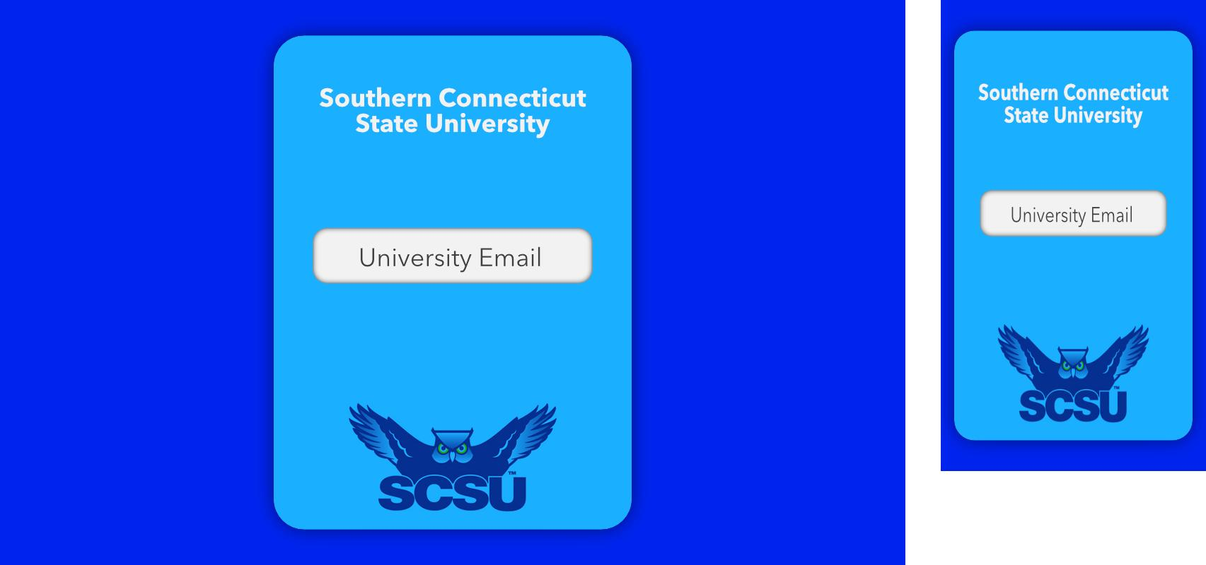
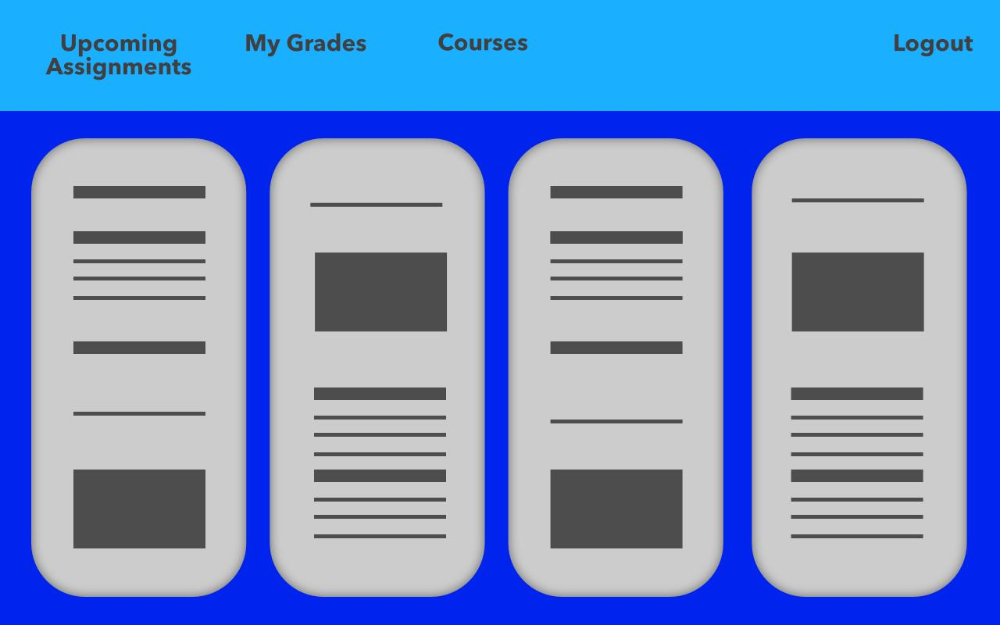
Mockup
Simple login
Routes to Student or Educator views
Single field for ‘safe user flow’
password field appears after
Explore various interface designs

